Slide 1
Project Echo for Pediatric Care 2018-2020
It’s Only A Virus
December 20, 2018
Michael J. Rock, MD
Provided by the University of Wisconsin–Madison Interprofessional Continuing Education Partnership (ICEP)
Intended Audience:
Pediatric emergency care professionals
Objectives:
As a result of this educational regularly scheduled series, learners will be able to:
1. Utilize new skills and guidelines determined to be safe for children when accessing pediatric trauma.
2. Identify proper tools and standardized practices in order to improve the diagnosis and treatment of pediatric patients.
3. Define roles and responsibilities of team members who triage pediatric emergencies in order to identify communication strategies that result in effective patient care.
Policy on Disclosure
It is the policy of the University of Wisconsin-Madison ICEP that the faculty, authors, planners, and other persons who may influence content of this CE activity disclose all relevant financial relationships with commercial interests* in order to allow CE staff to identify and resolve any potential conflicts of interest. Faculty must also disclose any planned discussions of unlabeled/unapproved uses of drugs or devices during their presentation(s). For this educational activity, all conflicts of interest have been resolved and detailed disclosures are listed below.
The University of Wisconsin-Madison ICEP defines a commercial interest as any entity producing, marketing, re-selling, or distributing health care goods or services consumed by, or used on, patients The University of Wisconsin-Madison ICEP does not consider providers of clinical service directly to patients to be commercial interests.
Name/Role | Financial Relationship Disclosures | Discussion of Unlabeled/Unapproved uses of drugs/devices in presentation?
Jonathan Kohler, MD Presenter, Chair | No relevant financial relationships to disclose | No
Veronica Watson Coordinator | No relevant financial relationships to disclose | No
Randi Cartmill, Coordinator | No relevant financial relationships to disclose | No
Benjamin Eithun, MSN, RN, Coordinator | No relevant financial relationships to disclose | No
Kim Sprecker, OCPD Staff | No relevant financial relationships to disclose | No
Michael J. Rock, MD, Presenter | No relevant financial relationships to disclose | No
 | No relevant financial relationships to disclose | No
Accreditation Statement
In support of improving patient care, the University of Wisconsin–Madison ICEP is jointly accredited by the Accreditation Council for Continuing Medical Education (ACCME), the Accreditation Council for Pharmacy Education (ACPE), and the American Nurses Credentialing Center (ANCC) to provide continuing education for the healthcare team.
Credit Designation Statements
American Medical Association (AMA)
The University of Wisconsin-Madison ICEP designates this live activity for maximum of 1.0 AMA PRA Category 1 Credits™. Physicians should claim only the credit commensurate with the extent of their participation in the activity.
American Nurses Credentialing Center (ANCC)
The University of Wisconsin-Madison ICEP designates this live activity for a maximum of 1.0 ANCC contact hours. The University of Wisconsin-Madison School of Nursing is Iowa Board of Nursing provider 350.
Continuing Education Units (CEUs)
The University of Wisconsin-Madison, as a member of the University Continuing Education Association (UCEA), authorizes this program for 0.1 CEUs or 1 hours.
Disclaimer: All photos and/or videos included in the following presentation are permitted by subjects or are not subject to privacy laws due to lack of patient information or identifying factors

Slide 2
Claiming credit
Follow the instructions below, and contact us at projectecho@surgery.wisc.edu with any questions.
1. Create account with the UW Interprofessional Continuing Education Partnership
https://ce.icep.wisc.edu
2. During the live presentation, and in the follow-up email, you will be provided a code. Text that code to a number we provide you, using a cell phone associated with your account.
Text JODDUM to 608-260-7097
(save this number as ECHO Credit, it will never change)
3. All done!! Log onto ICEP to view or print your credit letter.

Slide 3
Case presentation
11 month old with hypotonia, weak cough, developmental delay presented with cough and rapid breathing
PMH pertinent for a previous episode of rhinovirus with superimposed pneumonia, requiring intubation
Vitals: temp: 37.5; heart rate: 174 bpm; respiratory rate: 63 breaths/min
Exam: pertinent for tachypnea, belly breathing and on auscultation of the lungs, crackles
SpO₂ on room air: 78%
Nasal swab: Influenza A and B negative; RSV positive

Slide 4
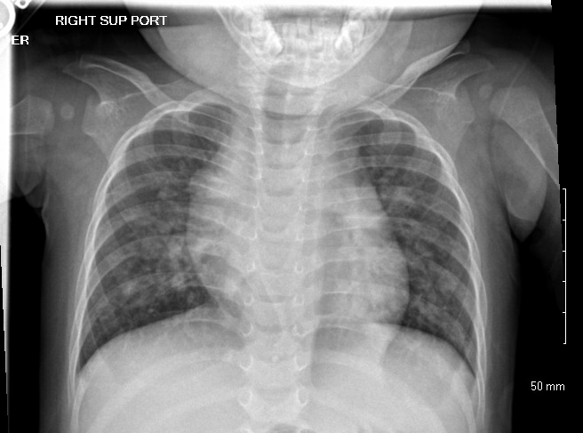
Venous blood gas: pH 7.31, pCO₂ 45 mmHg

Slide 5
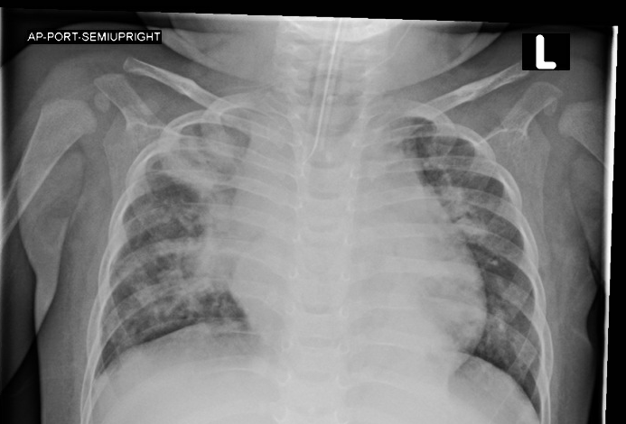
Despite BiPAP, child continued to be tachypneic and tachycardic. Intubated

Slide 6
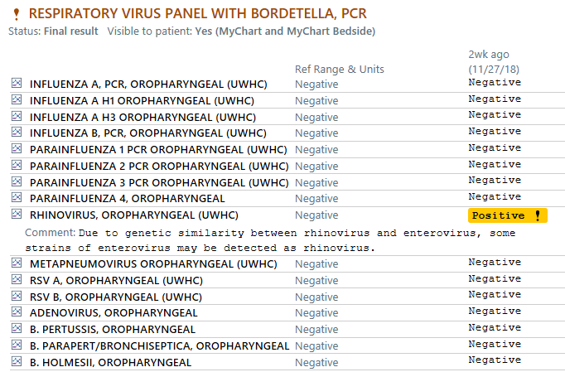
Respiratory viruses
RSV
Rhinovirus
Human metapneumovirus
Influenza
Adenovirus
Parainfluenza virus

Slide 7
RSV (Respiratory syncytial virus)
40-50% of hospitalizations for bronchiolitis
25% of pediatric hospitalizations for pneumonia
100,000 admissions annually costing $300 million

Slide 8
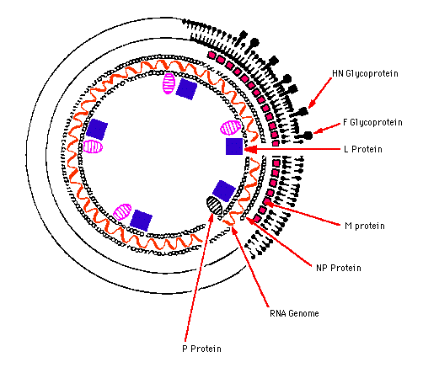
Paramyxovirus
3 genera
paramyxovirus: parainfluenza virus 1-4; mumps
pneumovirus: RSV
morbillivirus: mumps and rubeola

Slide 9
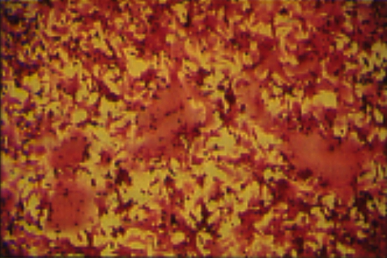
syncytia formation in tissue culture cells
fusion glycoprotein
confers ability to fuse cell membranes with the formation of intracellular bridges and ultimately multinucleated cells (syncytia)

Slide 10
RSV epidemiology
Season: November through April
Age: All ages
infants 6 weeks to 2 years are most susceptible
Attack rates: 50-95% in previously uninfected infants
re-infection throughout life

Slide 11
Primary RSV infection: spectrum of disease
% of patients
asymptomatic 1
upper respiratory tract
infection only 69
lower respiratory tract
illness 30
hospitalization 0.5-2
apnea 0.1-0.4
mortality 0.005-0.02

Slide 12
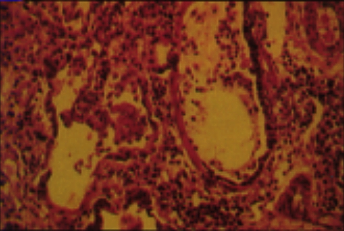
Pathogenesis
necrosis of respiratory epithelium
regeneration of non-ciliated epithelial cells
obstruction of airway by intraluminal secretions
lymphocytic peribronchiolar infiltrate
submucosal & interstitial edema

Slide 13
Clinical manifestations
profuse rhinorrhea, followed by cough
reduced feeding
fever is low grade or absent
tachypnea
± cyanosis
retractions
expiratory wheeze
inspiratory crackles

Slide 14
Treatment
Most cases managed without hospitalization
hydration
oxygen as necessary
Bronchodilators- not effective
Steroids- not effective
Ribavirin- not effective
Nebulized hypertonic saline- shown to not be useful in a recent multicenter randomized controlled trial (Morikawa Y, et al: Nebulized hypertonic saline in infants hospitalized with moderately severe bronchiolitis due to RSV infection: A multicenter randomized controlled trial. Pediatr Pulmonol 2018;53:358-365)

Slide 15
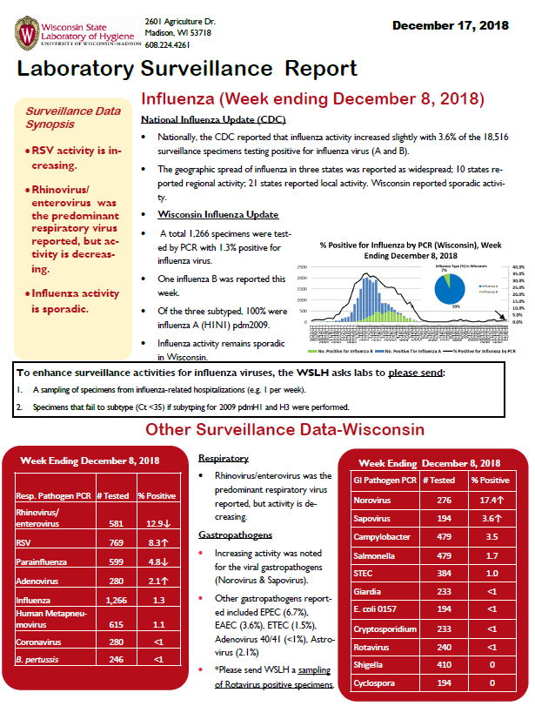
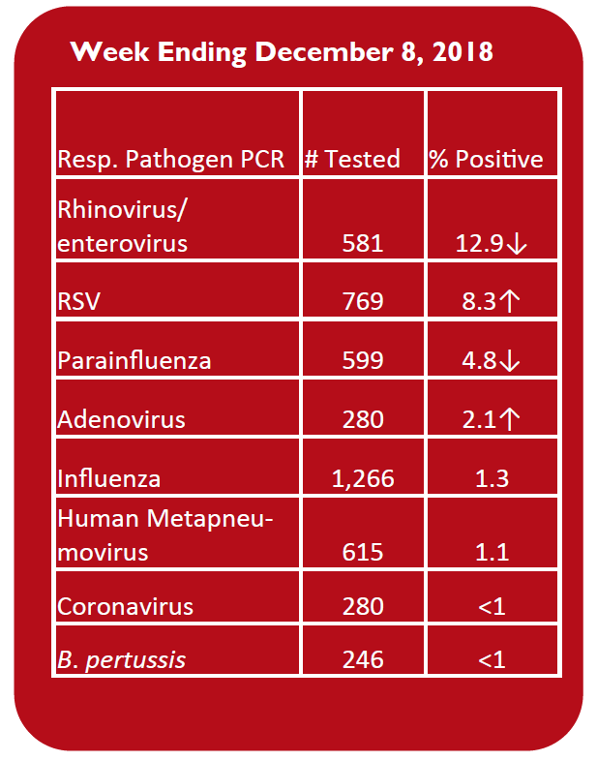
Laboratory surveillance

